Slide 1
Chapter 2
Application Layer
2-<number>

Slide 2
Chapter 2: Application layer
2.2 Web and HTTP
2-<number>

Slide 3
Web and HTTP
First some jargon
Web page consists of objects
Object can be HTML file, JPEG image, Java applet, audio file,…
Web page consists of base HTML-file which includes several referenced objects
Each object is addressable by a URL
Example URL:
www.someschool.edu/someDept/pic.gif
host name
path name
2-<number>

Slide 4
HTTP overview (continued)
Uses TCP:
client initiates TCP connection (creates socket) to server, port 80
server accepts TCP connection from client
HTTP messages (application-layer protocol messages) exchanged between browser (HTTP client) and Web server (HTTP server)
TCP connection closed
HTTP is “stateless”
server maintains no information about past client requests
2-<number>

Slide 5
HTTP connections
Nonpersistent HTTP
At most one object is sent over a TCP connection.
HTTP/1.0 uses nonpersistent HTTP
Persistent HTTP
Multiple objects can be sent over single TCP connection between client and server.
HTTP/1.1 uses persistent connections in default mode
2-<number>

Slide 6
Nonpersistent HTTP
Suppose user enters URL www.someSchool.edu/someDepartment/home.index
(contains text,
references to 10
jpeg images)
1a. HTTP client initiates TCP connection to HTTP server (process) at www.someSchool.edu on port 80
1b. HTTP server at host www.someSchool.edu waiting for TCP connection at port 80. “accepts” connection, notifying client
2. HTTP client sends HTTP request message (containing URL) into TCP connection socket. Message indicates that client wants object someDepartment/home.index
3. HTTP server receives request message, forms response message containing requested object, and sends message into its socket
time
2-<number>

Slide 7
Nonpersistent HTTP (cont.)
4. HTTP server closes TCP connection.
5. HTTP client receives response message containing html file, displays html. Parsing html file, finds 10 referenced jpeg objects
time
6. Steps 1-5 repeated for each of 10 jpeg objects
2-<number>

Slide 8

Nonpersistent HTTP (cont.) - Response time modeling
Definition of RTT: time to send a small packet to travel from client to server and back.
Response time:
one RTT to initiate TCP connection
one RTT for HTTP request and first few bytes of HTTP response to return
file transmission time
total = 2RTT+transmit time
initiate TCP
connection
syn
RTT
Syn-ack
ack
request
file
time to
transmit
file
RTT
file
received
time
time
2-<number>

Slide 9
Persistent HTTP
Persistent HTTP
server leaves connection open after sending response
subsequent HTTP messages between same client/server are sent over connection
Persistent without pipelining:
client issues new request only when previous response has been received
Persistent with pipelining:
default in HTTP/1.1
client sends requests as soon as it encounters referenced objects
2-<number>

Slide 10
Example
Suppose within your Web browser you click on a link to obtain a Web page. The IP address for the associated URL is not cached in your local host, so a DNS lookup is necessary to obtain the IP address. Suppose that n DNS servers are visited before your host receives the IP address from DNS; the successive visits incur an RTT of RTT1, . . ., RTTn.
    What is the total DNS response time?
Suppose that the Web page associated with the link contains exactly one object, consisting of a small amount of HTML text. Let RTT0 denote the RTT between the local host and the server containing the object. Assuming zero transmission time of the object.
    How much time elapses from when the client clicks on the link until the client receives the object?
Suppose the HTML base file references eight other objects on the same server. Neglecting transmission times, how much time elapses with:
    Non-persistent HTTP and without pipelining?
    Non-persistent HTTP with the browser configured for a max of 5 parallel http requests to be supported over the same TCP connection?
    Persistent HTTP (with pipelining and without pipelining)?
2-<number>

Slide 11
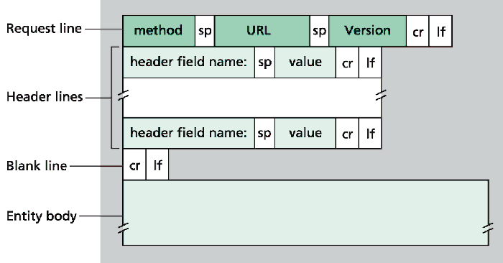
HTTP request message: general format
2-<number>

Slide 12
HTTP request message
HTTP request message:
request line
GET /somedir/page.html HTTP/1.1
Host: www.someschool.edu
User-agent: Mozilla/8.0
Connection: close
Accept-language:fr
(extra carriage return, line feed)
header
lines
Carriage return,
line feed
indicates end
of message
2-<number>

Slide 13
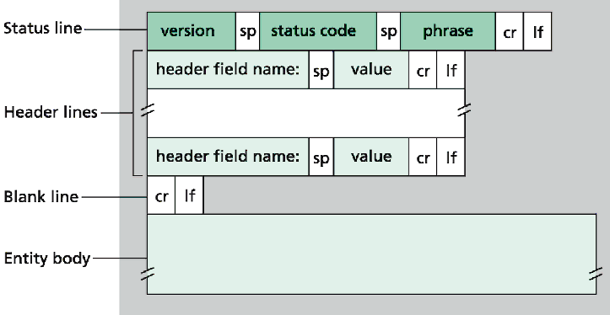
HTTP response message
2-<number>

Slide 14
HTTP response message
status line
(protocol
status code
status phrase)
HTTP/1.1 200 OK
Connection: close
Date: Thu, 06 Aug 2017 12:00:15 GMT
Server: Apache/1.3.0 (Unix)
Last-Modified: Mon, 22 Jun 2016 …...
Content-Type: text/html
Content-Length: 6821
data data data data data ...
header
lines
data, e.g.,
requested
HTML file
2-<number>

Slide 15
Chapter 2: Application layer
Building a Web server
2-<number>

Slide 16
Building a simple Web server
handles one HTTP request
accepts the request
Parses the request line
  obtains requested file from server’s file system
creates HTTP response message:
  header lines + file
sends response to client
2-<number>

Slide 17
Example: Web server
import java.io.*;
import java.net.*;
import java.util.*;
class Webserver {public static void main(String argv[]) throws Exception {
String requestMessageLine;
String fileName;
ServerSocket listenSocket = new ServerSocket(6789);
Socket connectionSocket = listenSocket.accept();
BufferedReader inFromClient =new BufferedReader(new InputStreamReader(connectionSocket.getInputStream()));
DataOutputStream outToClient =new DataOutputStream(connectionSocket.getOutputStream());
GET file_name HTTP/1.1
Create
welcoming socket
at port 6789
Wait, on welcoming
socket for contact
by client
Create input
stream, attached
to socket
Create output
stream, attached
to socket
2-<number>

Slide 18
Example: Web server
GET file_name HTTP/1.1
Read the first line of the HTTP request
requestMessageLine = inFromClient.readLine();
StringTokenizer tokenizedLine = new StringTokenizer(requestMessageLine);
if (tokenizedLine.nextToken().equals("GET")){
fileName = tokenizedLine.nextToken();
if (fileName.startsWith("/") == true )
fileName = fileName.substring(1);
Parse the first line
Remove the backslash that may precede the file name
2-<number>

Slide 19
Example: Web server
obtain a File instance
File file = new File(fileName);
int numOfBytes = (int) file.length();
byte[] fileInBytes = new byte[numOfBytes];
FileInputStream inFile = new FileInputStream (fileName);
inFile.read(fileInBytes);
Determine the file size
Create array of bytes with size numOfBytes
Attach a stream inFile to the fileName
Read from the stream inFile to the byte array fileInBytes
2-<number>

Slide 20
Example: Web server
outToClient.writeBytes(
"HTTP/1.0 200 OK\r\n") ;
if (fileName.endsWith(".jpg"))
outToClient.writeBytes("Content-Type: image/jpeg\r\n");
if (fileName. endsWith (". gif "))
outToClient.writeBytes("Content-Type: image/ gif \r\n");
outToClient.writeBytes("Content-Length: “+ numOfBytes + "\r\n”);
outToClient. writeBytes("\r\n”);
outToClient.write(fileInBytes, 0, numOfBytes);
connectionSocket.close();
Send the status line
Send blank line
Send the file to the TCP buffer
2-<number>

Slide 21
Web Systems Performance Analysis example
origin
servers
Assumptions
average object size = 1Mbits
avg. request rate from institution’s browsers to origin servers = 15/sec
delay from institutional router to any origin server and back to router = 2 sec
Consequences
utilization on LAN = 15%
utilization on access link = 100%
total delay = Internet delay + access delay + LAN delay
= 2 sec + minutes + milliseconds
ISP and
public
Internet
15 Mbps
access link
institutional
network
100 Mbps
LAN Link
2-<number>

Slide 22
Web Systems Performance Analysis example
origin
servers
Possible solution
increase bandwidth of access link to, say, 100 Mbps
Consequences
utilization on LAN = 15%
utilization on access link = 15%
Total delay = Internet delay + access delay + LAN delay
= 2 sec + msecs + msecs
often a costly upgrade
public
Internet
100 Mbps
access link
institutional
network
100 Mbps LAN
2-<number>

Slide 23
Web Systems Performance Analysis example
origin
servers
Install cache
suppose hit rate is .4
Consequence
40% requests will be satisfied almost immediately
60% requests satisfied by origin server
utilization of access link reduced to 60%, resulting in negligible delays
total avg delay = Internet delay + access delay + LAN delay = .6*(2.01) secs + milliseconds < 1.4 secs
public
Internet
1.5 Mbps
access link
institutional
network
100 Mbps LAN
institutional
cache
2-<number>

Slide 24
Web caches (proxy server)
Goal: satisfy client request without involving origin server
user sets browser: Web accesses via cache
browser sends all HTTP requests to cache
  object in cache: cache returns object
  else cache requests object from origin server, then returns object to client
origin
server
Proxy
server
HTTP request
HTTP request
client
HTTP response
HTTP response
HTTP request
HTTP response
client
origin
server
2-<number>

Slide 25
More about Web caching
Cache acts as both client and server
Typically cache is installed by ISP (university, company, residential ISP)
Why Web caching?
Reduce response time for client request.
Reduce traffic on an institution’s access link.
Internet dense with caches enables “poor” content providers to effectively deliver content (but so does P2P file sharing)
2-<number>

Slide 26
Conditional GET
cache
server
Goal: don’t send object if cache has up-to-date cached version
cache: specify date of cached copy in HTTP request
  If-modified-since: <date>
server: response contains no object if cached copy is up-to-date:
  HTTP/1.0 304 Not Modified
HTTP request msg
If-modified-since: <date>
object
not
modified
HTTP response
HTTP/1.0
304 Not Modified
HTTP request msg
If-modified-since: <date>
object
modified
HTTP response
HTTP/1.0 200 OK
<data>
2-<number>

Slide 27
User-server state: cookies
Many major Web sites use cookies
Four components:
  1) cookie header line in the HTTP response message
  2) cookie header line in HTTP request message
  3) cookie file kept on user’s host and managed by user’s browser
  4) back-end database at Web site
Example:
  Susan access Internet always from same PC
  She visits a specific e-commerce site for first time
  When initial HTTP requests arrives at site, site creates a unique ID and creates an entry in backend database for ID
2-<number>

Slide 28
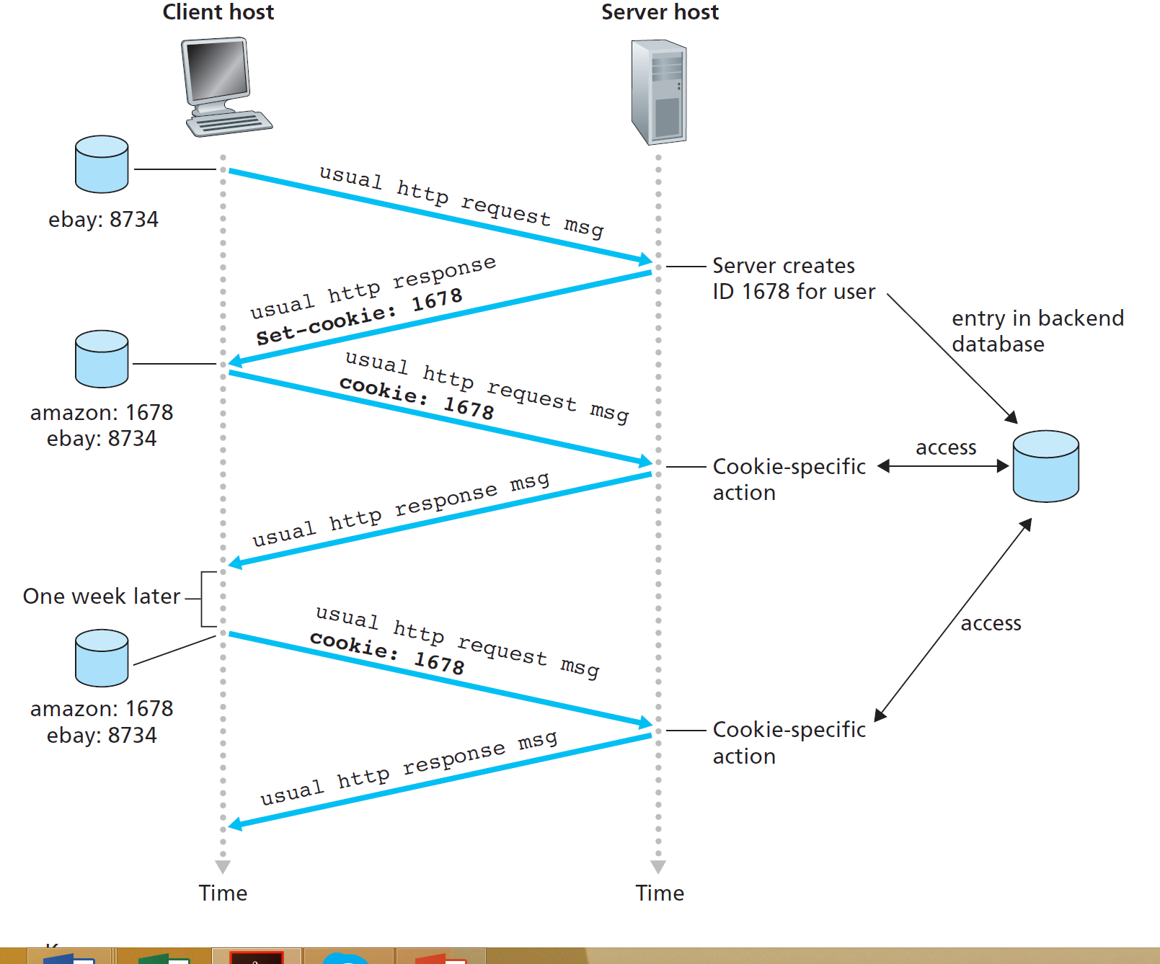
User-server state: cookies
2-<number>

